Slide 1
Data analysis nano degree
Session 6
Conducted by hamza

Slide 2
Agenda
Correlation
Linear regression
Logistic regression
Project

Slide 3
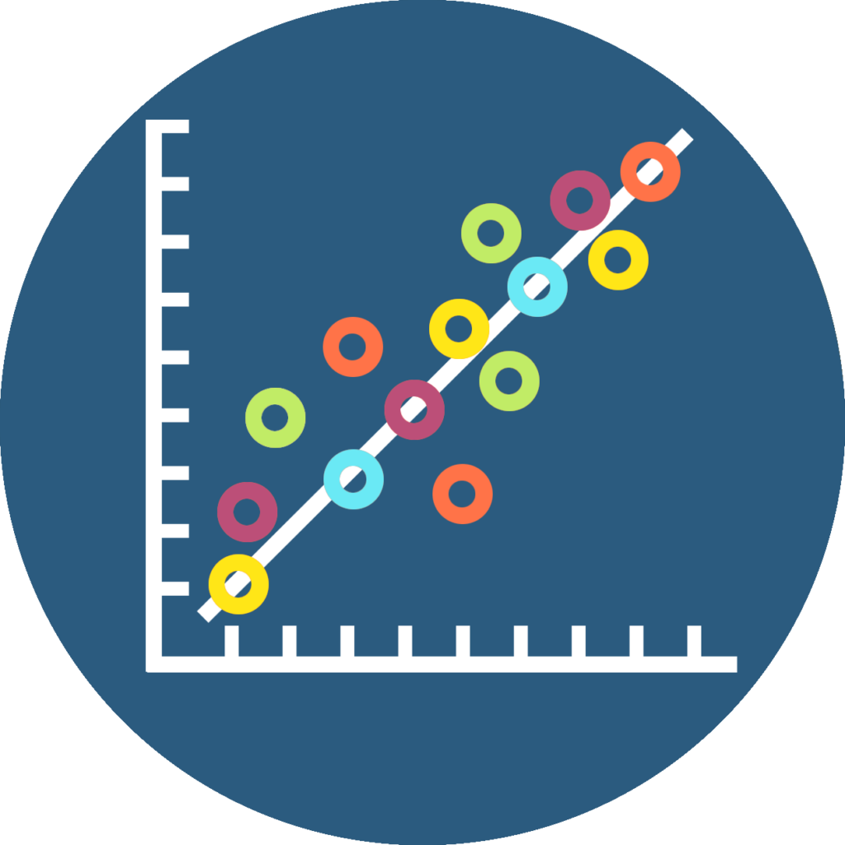
Do we need regression?
Correlation is not enough ?

Slide 4

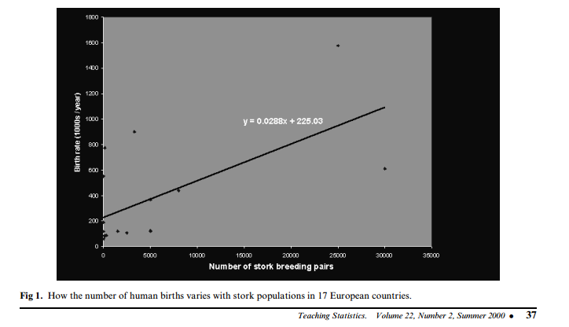
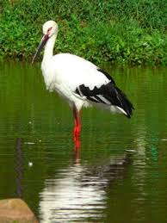
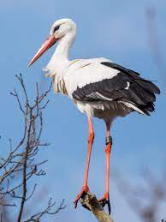
Storks Deliver Babies (p  0.008)
r = 0.62
Notes:
There is a high correlation between the number of storks in an area and the number of babies born. This was observed in the city of Copenhagen by looking at records of number of births and the number of storks over a 10-year period after World War II.1 It turns out that after the war, more people moved to Copenhagen (so more babies were born there) and more construction was going on in the city (so storks had more places, thus more storks).
<number>

Slide 5
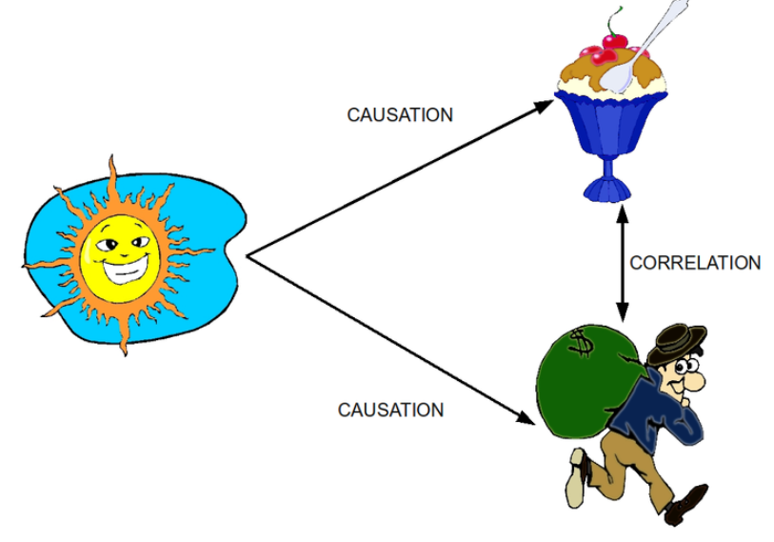
Spurious correlations
http://www.tylervigen.com/spurious-correlations
P < 0.05
R = 0.7
Notes:
This is a drawing illustrating the relationship between correlation and causation. It depicts a correlation between ice cream consumption and crime, but shows that the actual cause is temperature.
<number>

Slide 6
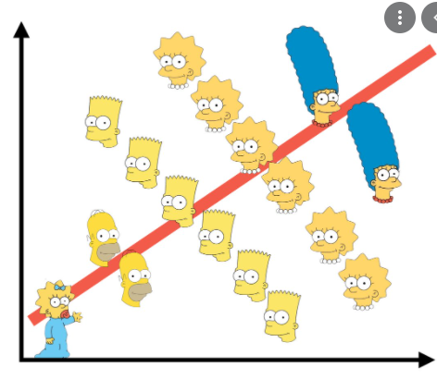
Simpsons paradox
How Can we solve it?

Slide 7
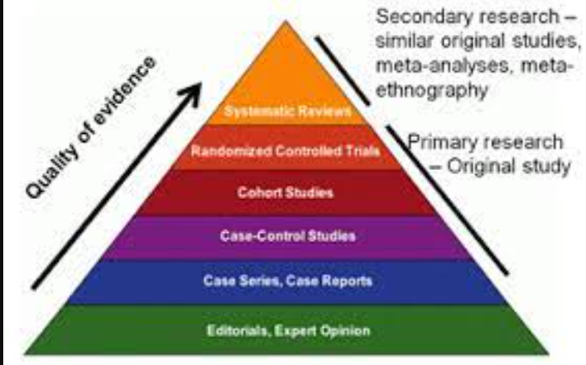
evidence

Slide 8
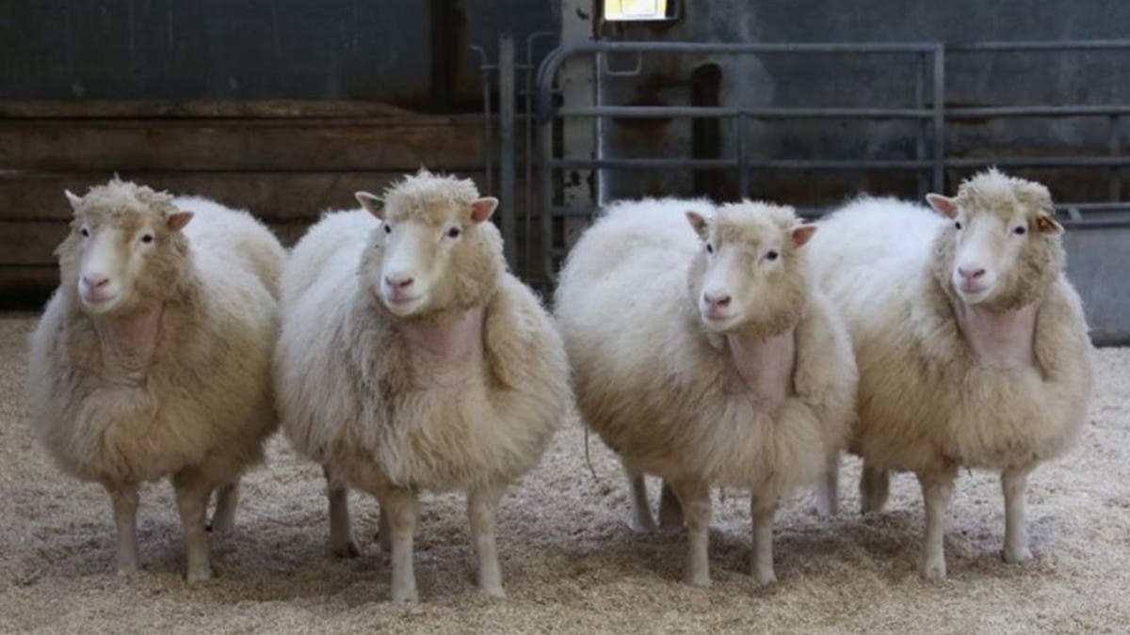
Randomization

Slide 9
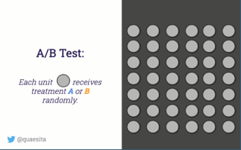

Slide 10

Default action?
Notes:
Blue is default
<number>

Slide 11
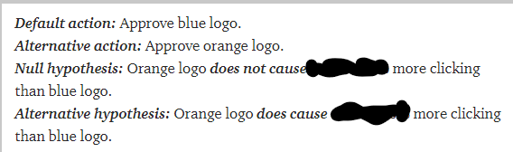
Scientific summary
What’s missing?

Slide 12
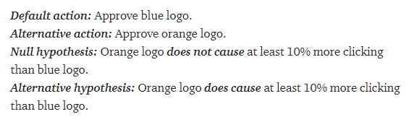
Scientific summary

Slide 13
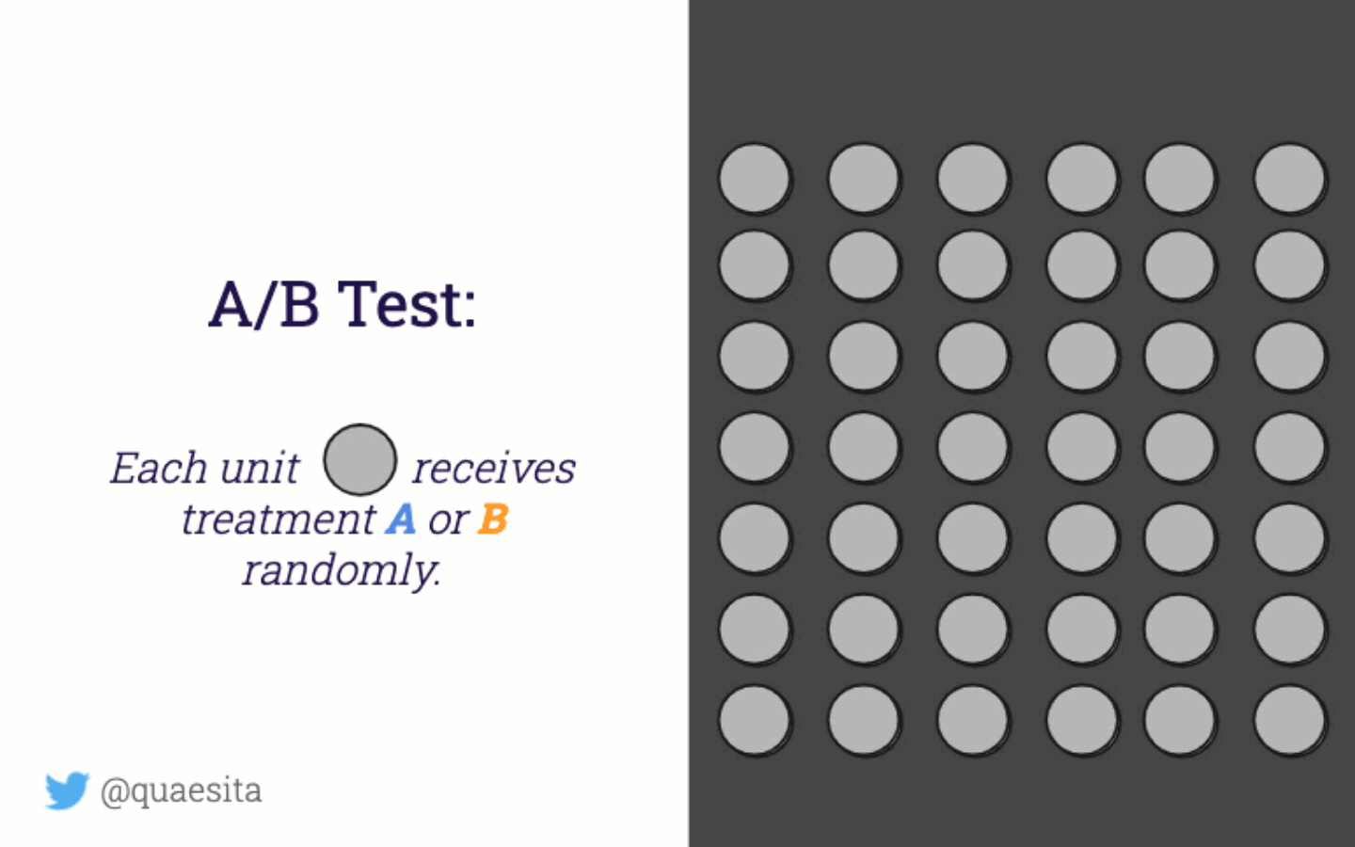

Slide 14
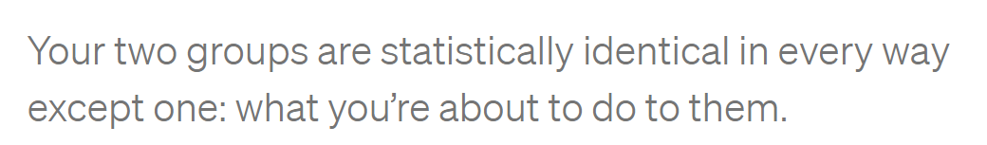

Slide 15
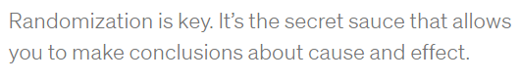
Cassie kozyrgov

Slide 16

Randomizaion Not always possible
Notes:
<number>

Slide 17

Welcome to multivariate regression
Notes:
<number>

Slide 18
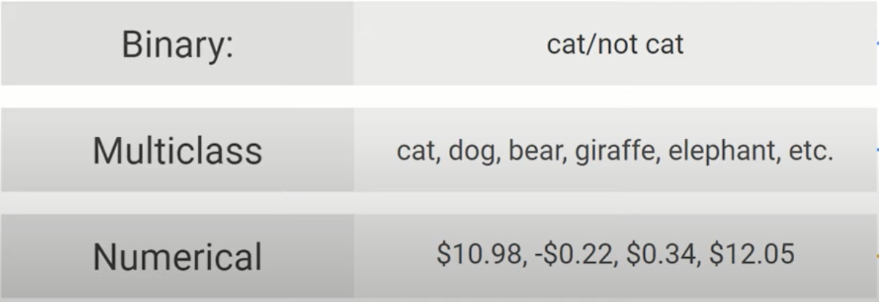
How to choose?

Slide 19
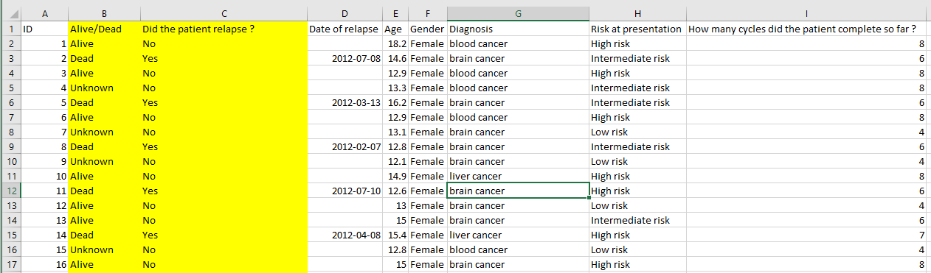
Which model?
Risk dictates chemo cycles
Notes:
<number>

Slide 20
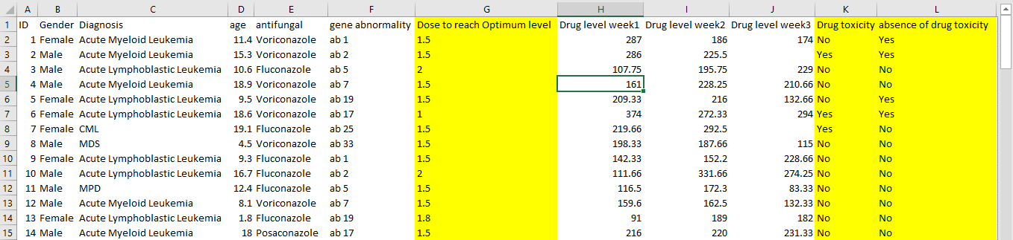
Is it safe?
Notes:
<number>

Slide 21
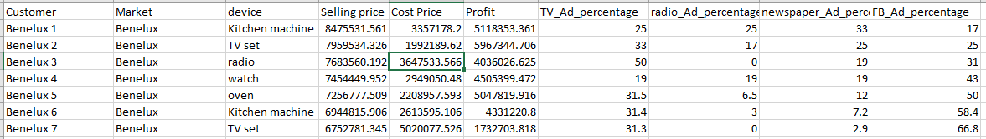
Anything wrong?

Slide 22
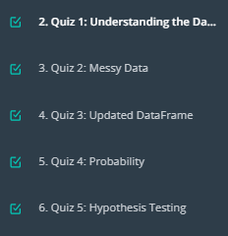
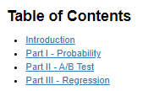
A/B testing Project

Slide 23
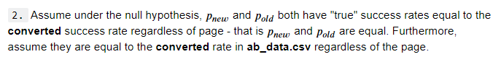
Part II - A/B Test
state your hypothesis
Notes:
<number>

Slide 24
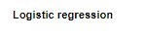
Part III - A regression approach

Slide 25
Breakout room1
https://campus.datacamp.com/courses/introduction-to-python-de9bedd8-983f-4a5b-a614-3d01d76e614e/testing?ex=2 Z test
[typo in alternative hypothesis exercise – t test instead of Z test)
https://campus.datacamp.com/courses/introduction-to-python-de9bedd8-983f-4a5b-a614-3d01d76e614e/67436?ex=1
Dataset description:
https://stat.ethz.ch/R-manual/R-devel/library/datasets/html/mtcars.html

Slide 26
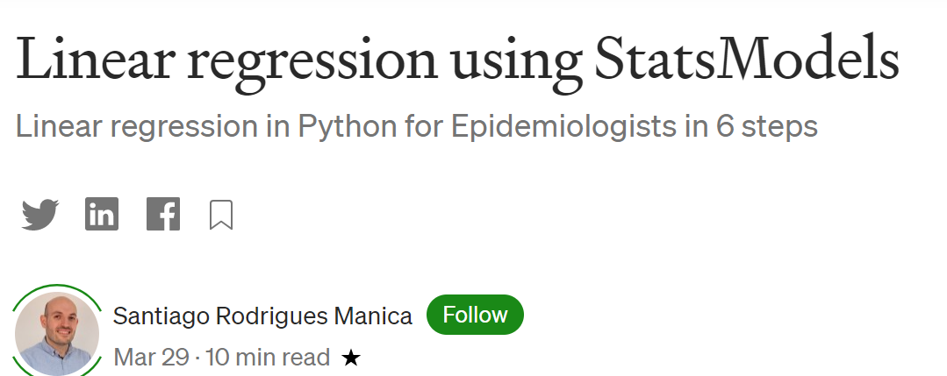
demo
Notes:
Linear regression using StatsModels | by Santiago Rodrigues Manica | EvidentEBM | Medium
https://medium.com/evidentebm/linear-regression-using-statsmodels-d0db5fef16bb
<number>

Slide 27
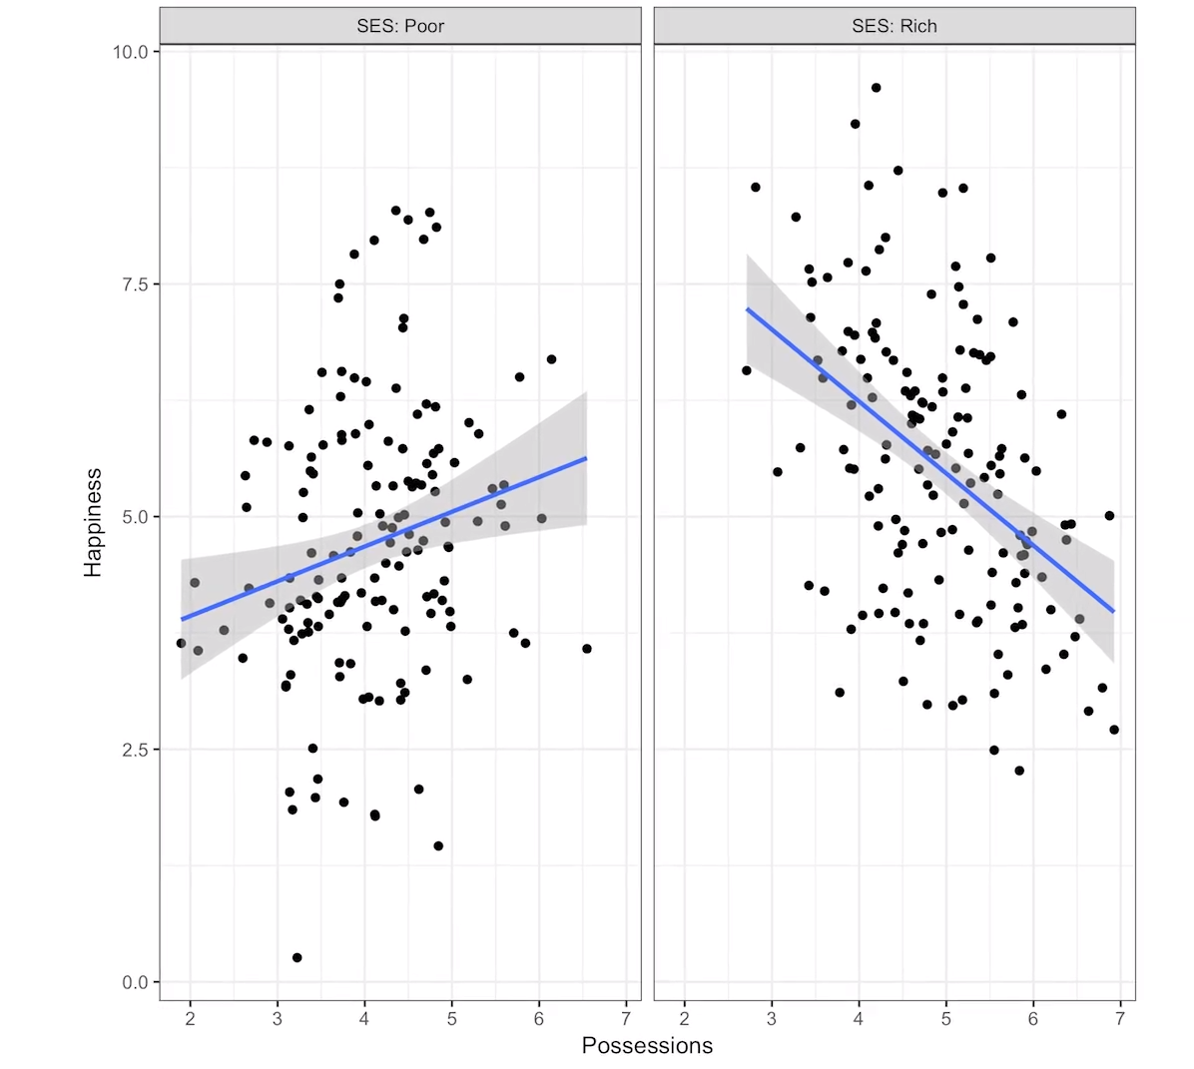
Interaction
GLM Part 6: Interaction effects: How to interpret and identify them - YouTube https://www.youtube.com/watch?v=3CCkeFShB3U

Slide 28
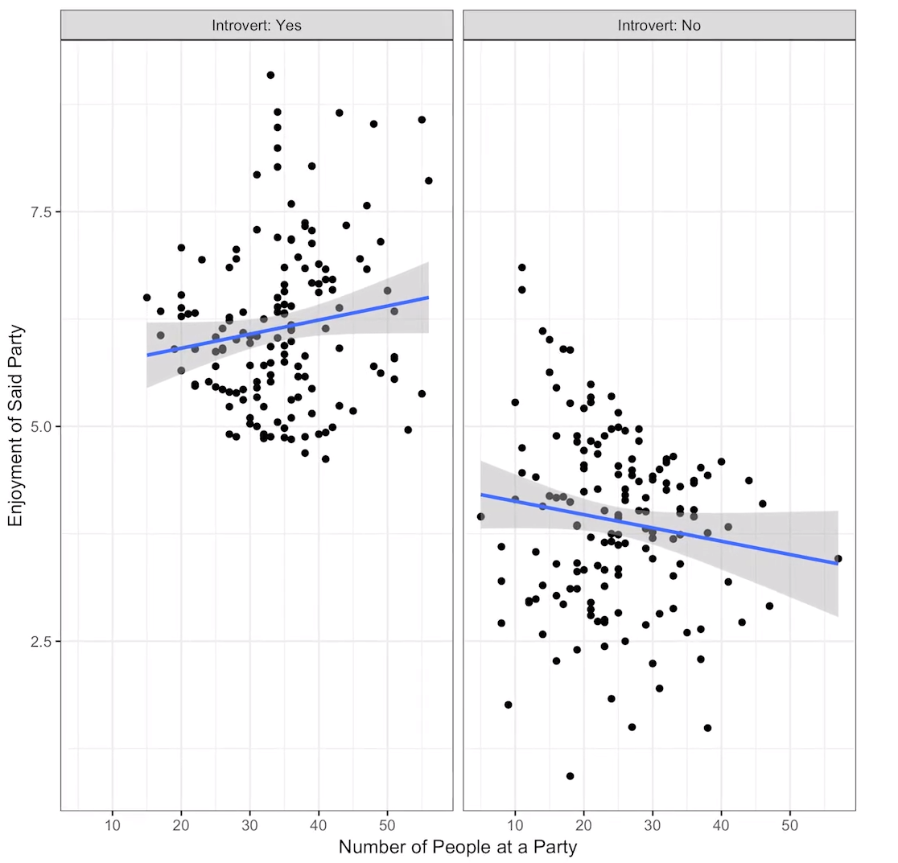

Slide 29
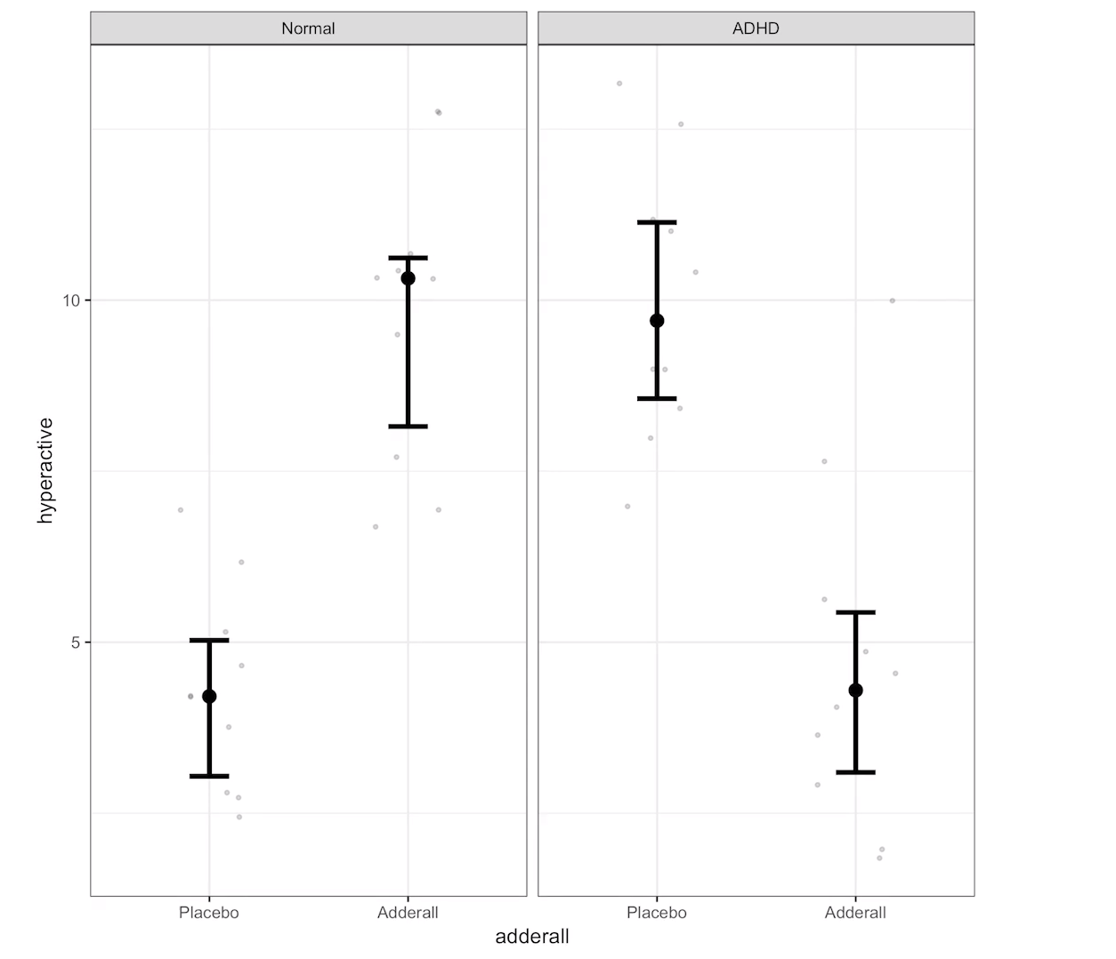

Slide 30
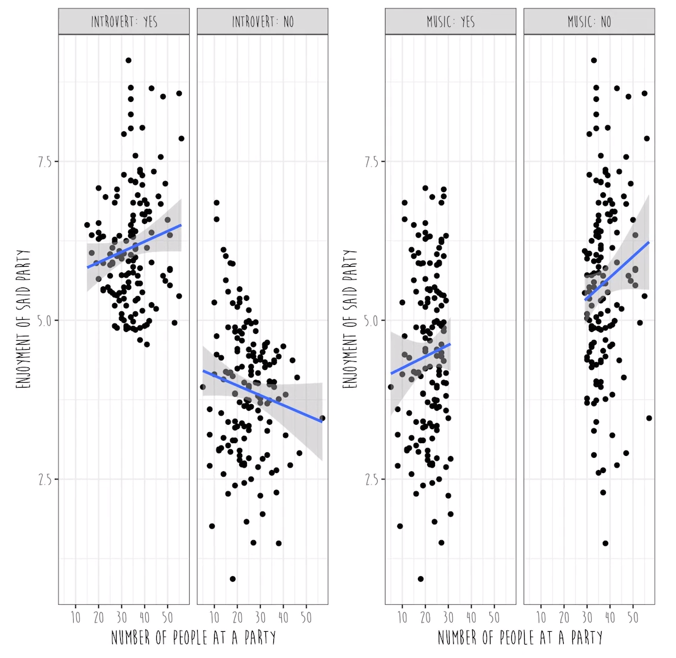

Slide 31


Slide 32
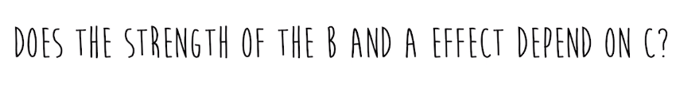

Slide 33
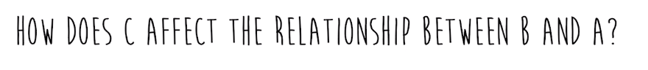

Slide 34
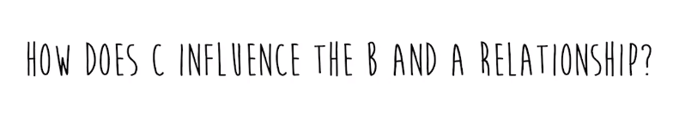

Slide 35
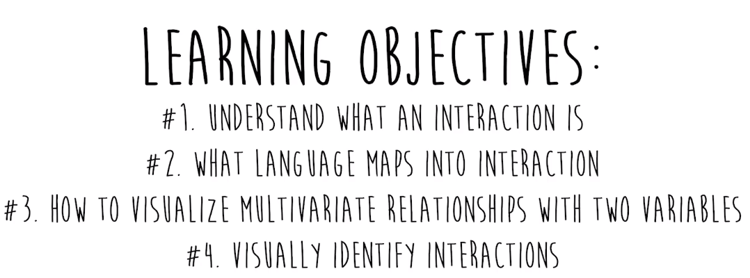

Slide 36
Another point of view
Welcome to machine learning

Slide 37
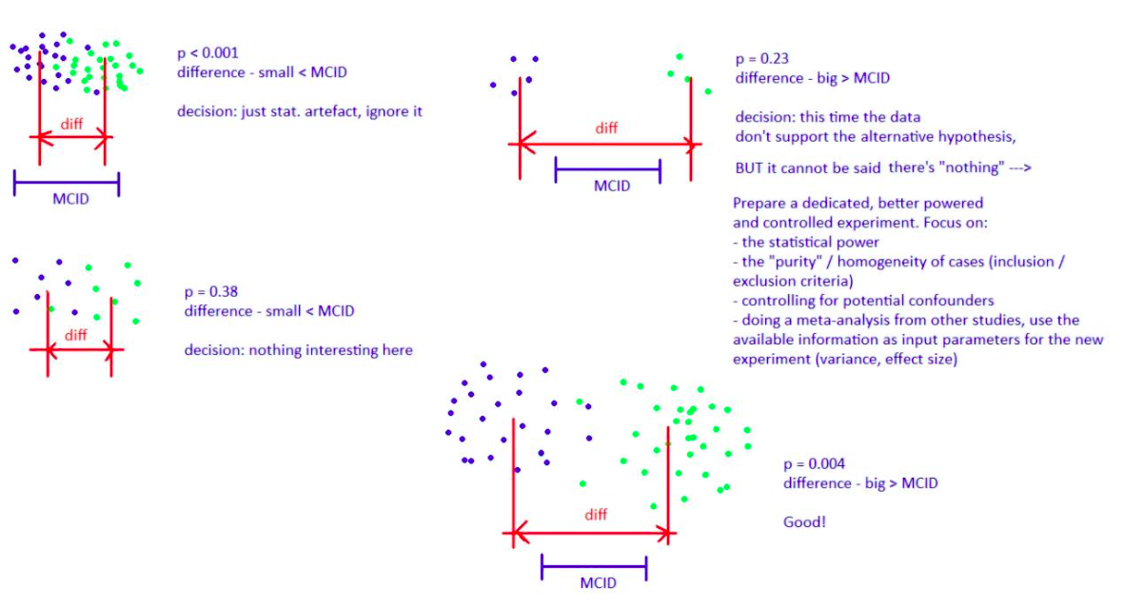
adrian olszewski Linkedin

Slide 38
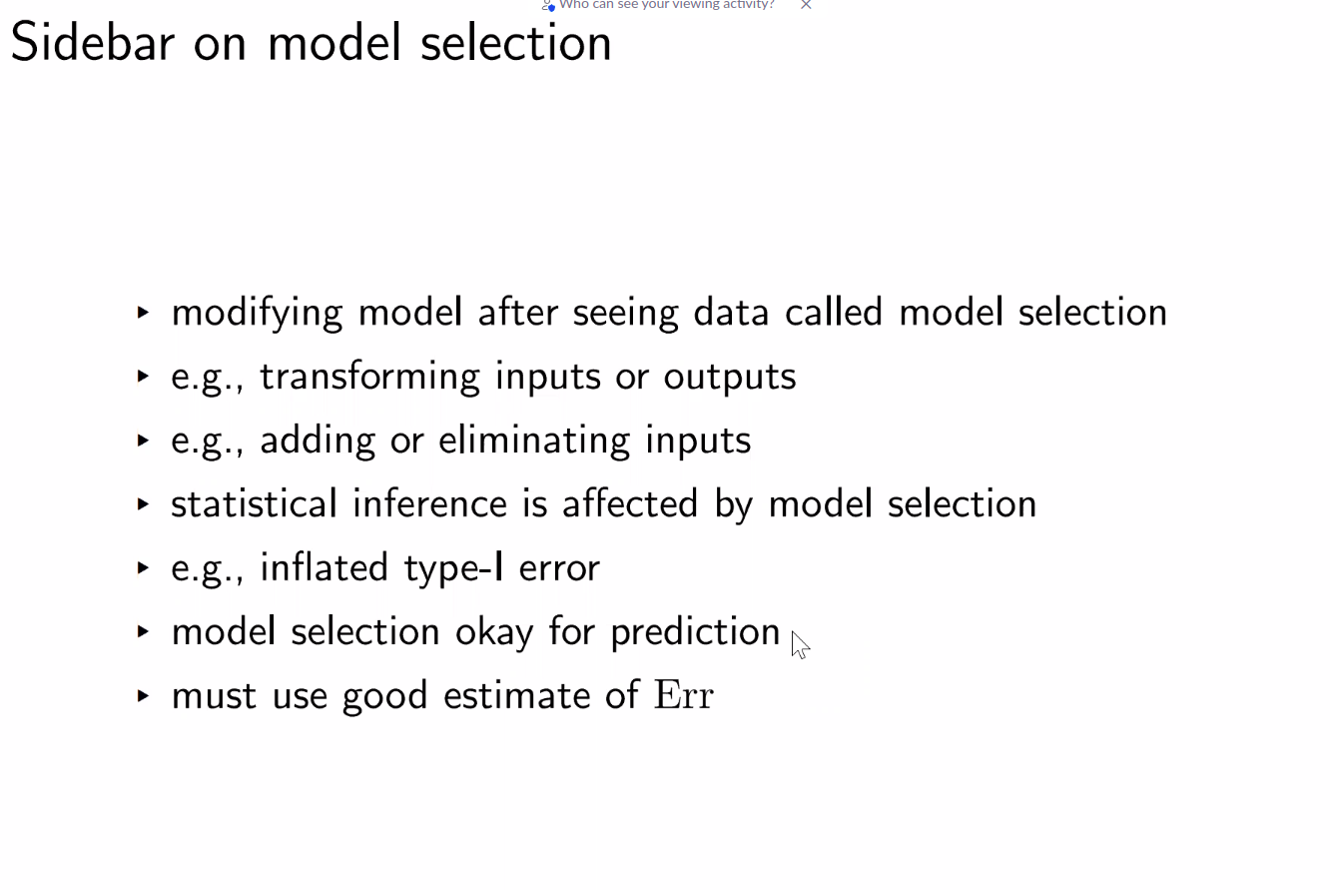
Matt shotwell presentation

Slide 39
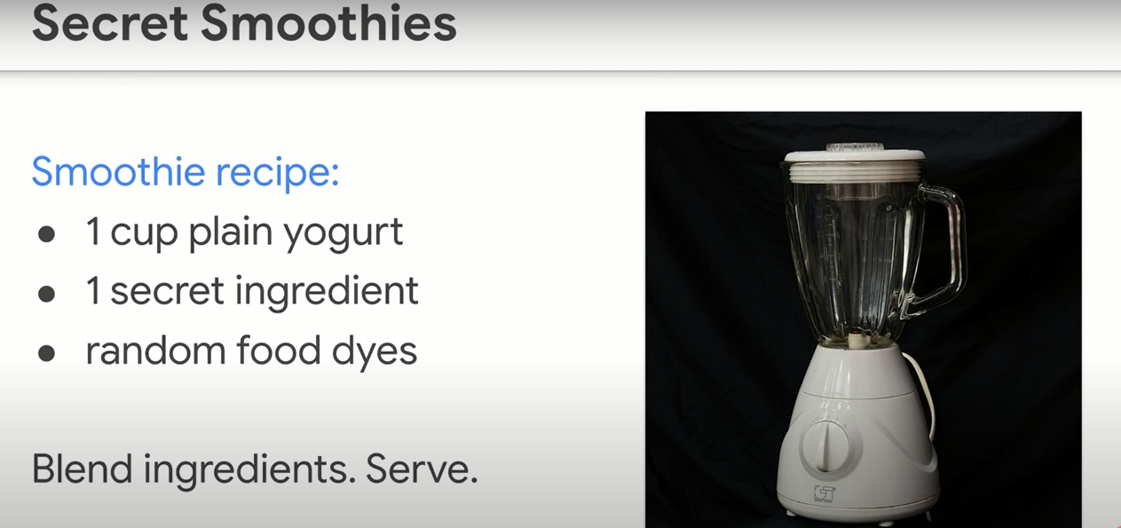
regression

Slide 40
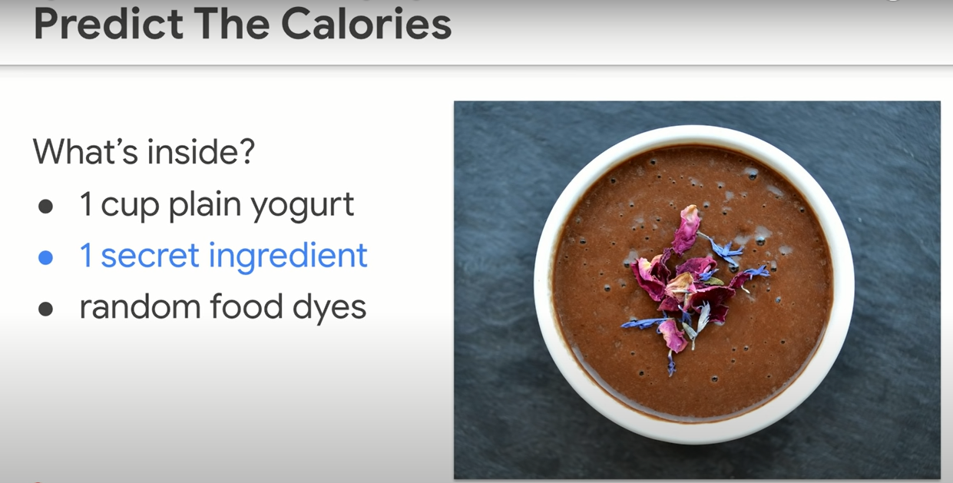
Guess!

Slide 41
Attitude of machine learning
Think carefully - perfectionism – get it right on the first shot
Give it a shot! – get it wrong – try again – ITERATE

Slide 42
Brave enough?
Let’s iterate …
Unlocking the next slide ☺

Slide 43
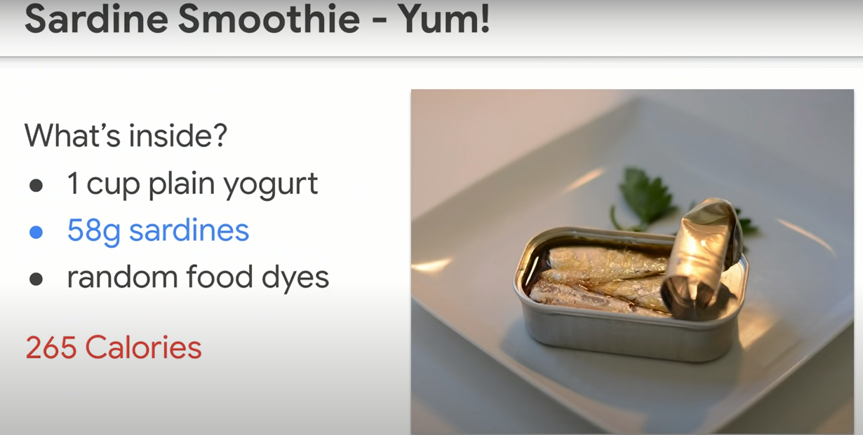

Slide 44
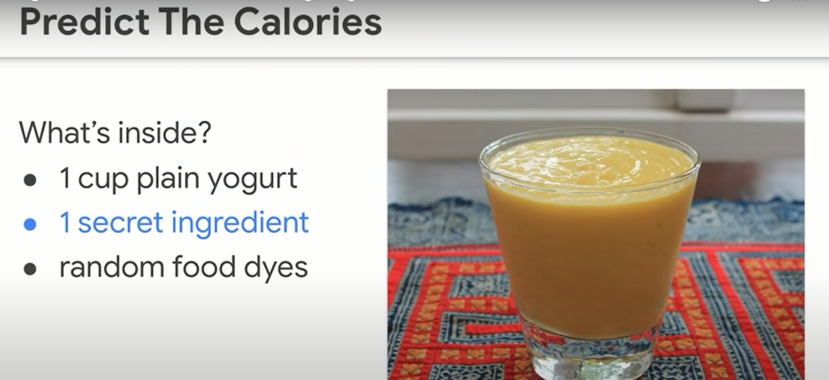
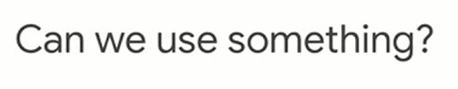
Notes:
We’ve been guessing based on no info
Can we have some info to guess based on ?
<number>

Slide 45
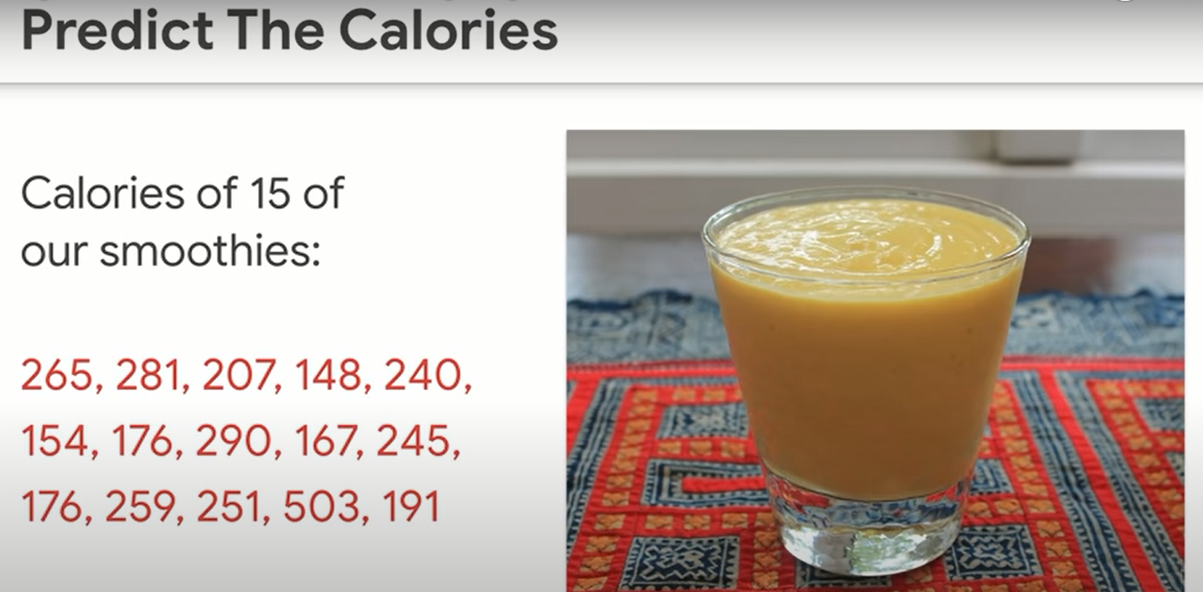
How to use the info?

Slide 46
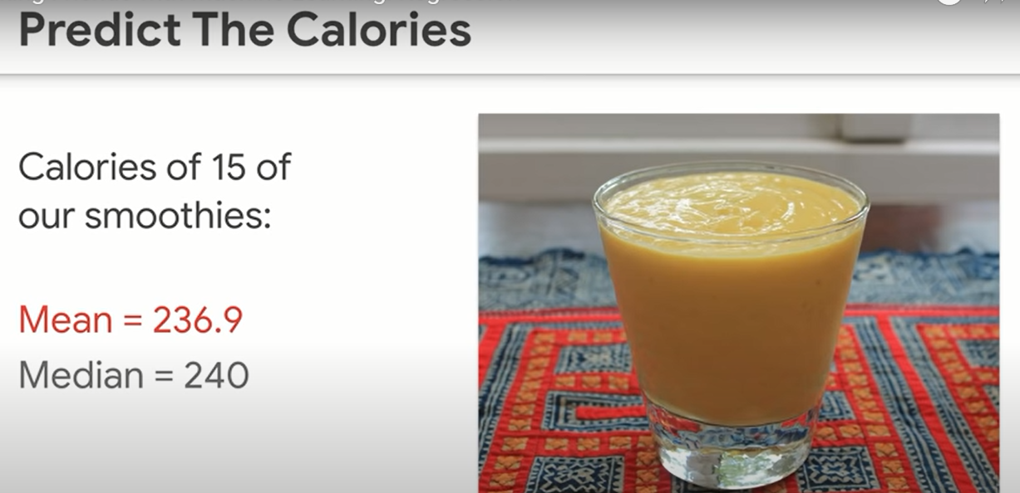
Guess now
Notes:
Notice how the guesses has narrowed now. Based on the new info
<number>

Slide 47
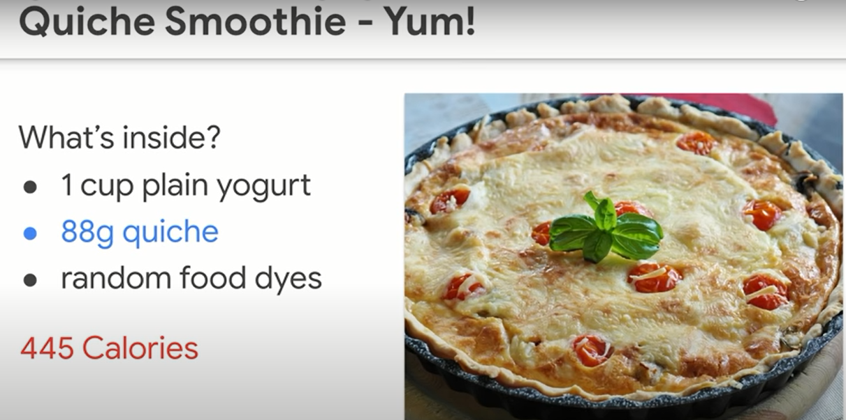
A bad guess ☹

Slide 48
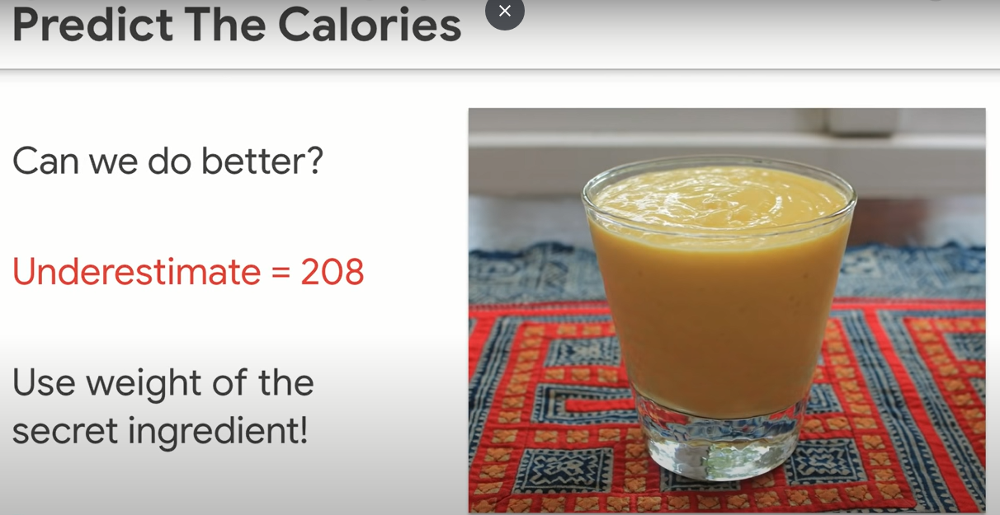

Slide 49
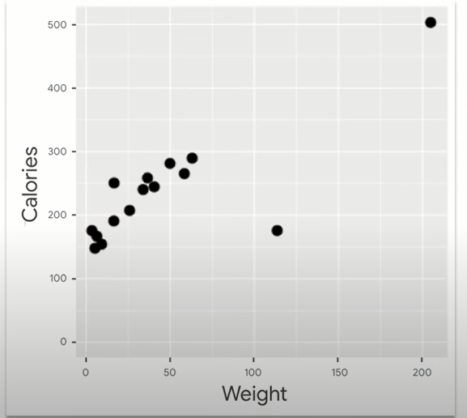
Is weight useful?

Slide 50
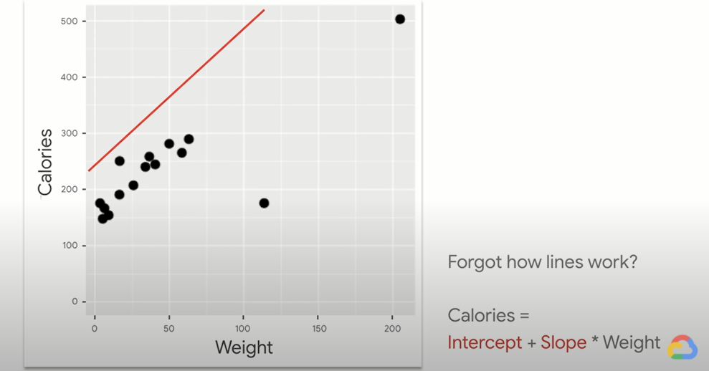
Regression: putting line through stuff

Slide 51
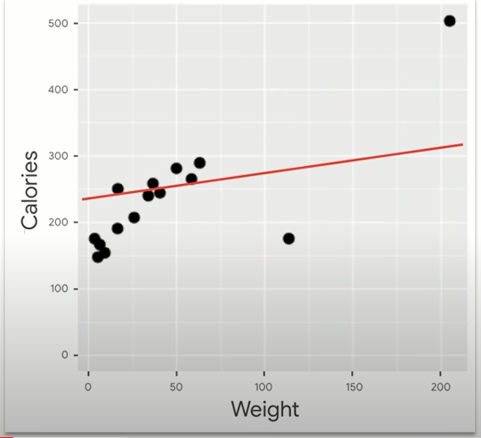
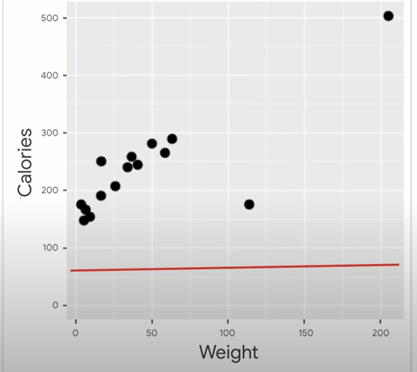

Slide 52
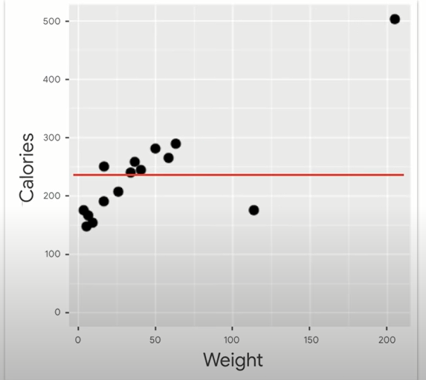
This one!
Why not?
Notes:
<number>

Slide 53
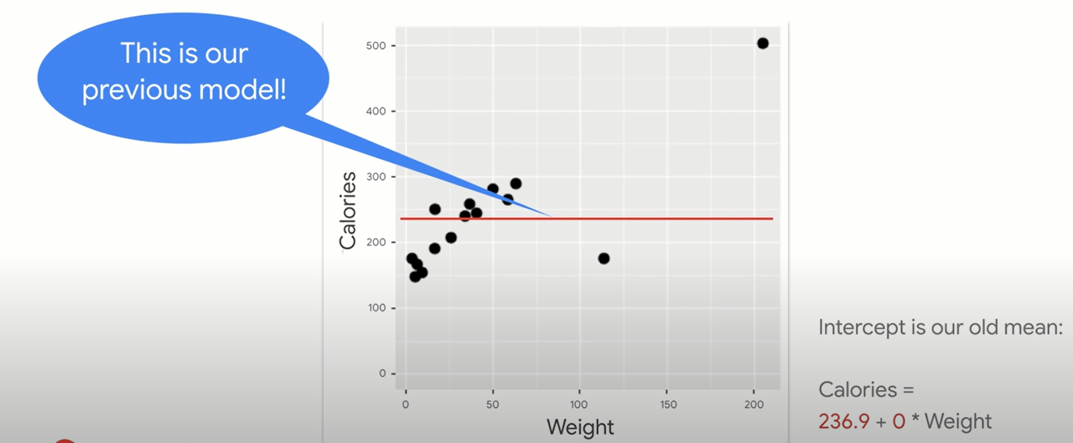
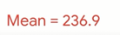
Weight is useless
Notes:
<number>

Slide 54
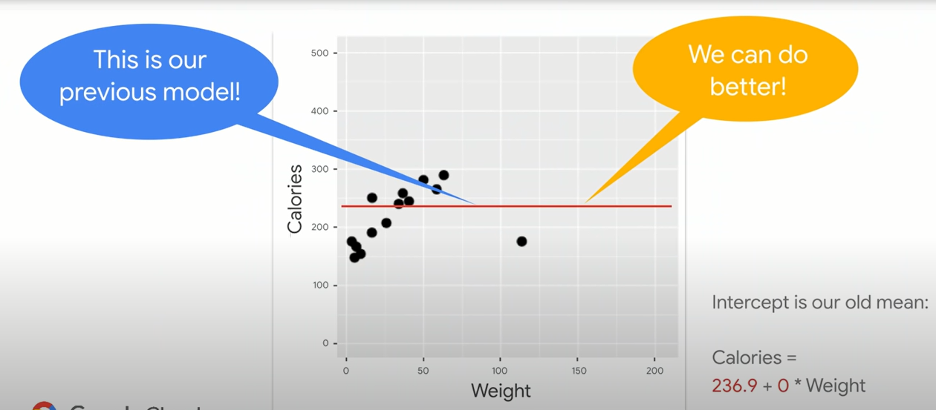
We have a feature

Slide 55

Notes:
RMSE = inversely named
Error, square it, Mean (take average), then root (sq root)
<number>

Slide 56

Best fit line?

Slide 57


Slide 58


Slide 59


Slide 60


Slide 61


Slide 62
Heart of machine learning
Know ur score(eg. RMSE)
Play with parameters(intercept and slope) to minimize ur error

Slide 63


Slide 64

Not much

Slide 65


Slide 66


Slide 67

IT WAS A LINE
Statistics?
Notes:
In stats, we needed p values/ R sq adjusted R squared, etc….
Here… just optimize
<number>

Slide 68

NOW A PLANE

Slide 69


Slide 70

ENOUGH IMPROVEMENT?
Notes:
I added a new feature and I only get this improvement?
<number>

Slide 71


Slide 72
Machine learning pillar!
Does it take a long time to try it?
If No, then do it. Even if it’s not very justified
Notes:
That’s an essence in machine learning.
<number>

Slide 73


Slide 74

Any guesses?
Notes:
9:4:4
Magic numbers
<number>

Slide 75
9:4:4 nutrition rule
Notes:
9:4:4
Magic numbers
<number>

Slide 76

Notes:
<number>

Slide 77

9:4:4

Slide 78

Feature engineering
What’s this 143?
Notes:
<number>

Slide 79

Notes:
If we added water a secret ingredient
We get 143
<number>

Slide 80


Slide 81


Slide 82


Slide 83


Slide 84

Train – test - validate …
Notes:
As usual, our favorite bumbler forgot to buy the assigned textbook, but, luckily, he jotted down an equation from the blackboard (it’s the 90s) and now he’s got one night to learn enough to pass your exam. You’re his calculus prof in this story, by the way — I applaud your patience.
<number>

Slide 85

What he got..
No more examples [data points]
No explicit rules
Notes:
No explicit rules ( that’s the opposite of ML]
No other examples for ML to learn
<number>

Slide 86

Training
Notes:
Just like an AI algorithm, his goal is to find a data pattern that he can turn into a recipe (“model”) that successfully takes him from the input on the left of the “=” to the output on the right-hand side.
<number>

Slide 87

Found the pattern
Fits perfectly!
Go to exam?
Notes:
<number>

Slide 88

Try another example!!
Notes:
That’s exactly what validation (step 8) in machine learning is. Validation creates a safe, low-stakes opportunity for students to try their recipes on examples they haven’t studied explicitly. That’s how they get a signal about whether they’re ready for the real exam.
<number>

Slide 89

More examples before exam
Notes:
(Mr. Bean is very lucky to have a professor like you. Thank you for sending him additional examples to try in the comfort and safety of his dorm room!)
<number>

Slide 90


Tries his model

Slide 91

What now?
start over
go to the exam anyway.
Notes:
12 Steps to Applied AI. A roadmap for every machine learning… | by Cassie Kozyrkov | The Startup | Medium
https://medium.com/swlh/12-steps-to-applied-ai-2fdad7fdcdf3
If he chooses to start over, he might go back to training (step 6) and search for new patterns in the data he already has (that single paltry datapoint) or he might go even further back and consider adjusting the data he’s working with (if it were me, I’d be begging you for a bunch of additional examples, which would mean going all the way back to step 2 in my guide).
Students (and ML/AI engineers) are allowed to bounce back and forth between looking for patterns and validating their new recipes as much as they like. (But don’t stay up all night studying!)
<number>

Slide 92

3 am
Notes:
Finally, at 3 AM, Mr. Bean found a pattern that works correctly on all the validation examples you’ve given him.
<number>

Slide 93

Notes:
You’re practically roaring, “Of course not!!!!”
<number>

Slide 94

Testing phase in ML/AI

Slide 95

Fits perfectly!
Notes:
For all you know, he might have hacked together a crazy recipe that overfits, er, contorts itself to fit those specific examples he has been staring at all night. Perhaps he has just memorized all the answers and that’s his recipe — looking them up from memory. There’s no guarantee he understands anything general enough to handle new problems.
<number>

Slide 96

No trust
How well he performs on new tasks

Slide 97

Notes:
So, is Mr. Bean’s best good enough? Should you give him a pass to go on to the next step (where you productionize him for mathematics in the wild) or should you delicately suggest he switch majors?
<number>

Slide 98

Fails on testing? Game over…

Slide 99

Notes:
Training, validation, and test phases in AI — explained in a way you’ll never forget | by Cassie Kozyrkov | Towards Data Science
https://towardsdatascience.com/training-validation-and-test-phases-in-ai-explained-in-a-way-youll-never-forget-744be50154e8
<number>

Slide 100



Notes:
If all you care about is failing unworthy students, you don’t need a validation phase. All you need is testing. Poor Mr. Bean trains, finds a pattern (it was a stupid pattern), rushes to your exam, fails the exam, and gets kicked out of the math major. You caught and executed an ignoramus. Great job!
<number>

Slide 101
Testing: Only the worthy should pass!
What about helping students to improve?
Notes:
<number>

Slide 102
Testing: Only the worthy should pass!
Validation: helping students improve
Notes:
<number>

Slide 103

The question
Notes:
If you really care about your students, it would be sad to find out that their attempts at a recipe are silly only after it’s too late to help them. (On the final exam itself.) What are you, a teacher or an executioner?
<number>

Slide 104

Notes:
How to be an AI idiot. 7 ways to royally mess up your machine… | by Cassie Kozyrkov | Towards Data Science
https://towardsdatascience.com/how-to-be-an-ai-idiot-8559c65d91a8
<number>

Slide 105
Breakout room 2
https://learn.datacamp.com/projects/558
https://learn.datacamp.com/courses/supervised-learning-with-scikit-learn
https://www.datacamp.com/community/tutorials/preprocessing-in-data-science-part-1-centering-scaling-and-knn
https://www.datacamp.com/community/tutorials/preprocessing-in-data-science-part-2-centering-scaling-and-logistic-regression
https://www.datacamp.com/community/tutorials/preprocessing-in-data-science-part-3-scaling-synthesized-data

Slide 106
Shiny experience
https://gallery.shinyapps.io/simple_regression/

